Slide 1


| Phrozen GO |
Remote Control App
2022.12.29 Launch

Slide 2
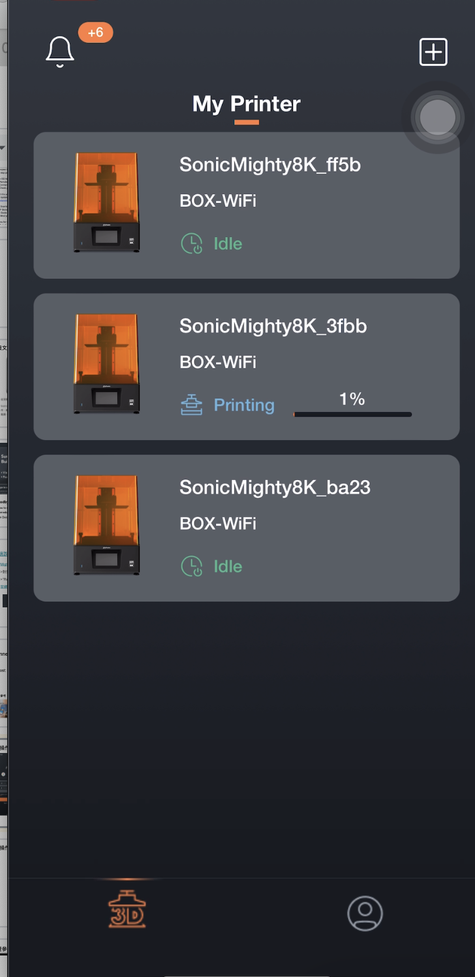
Phrozen GO - Remote Control App
Phrozen GO is a mobile application designed for Phrozen Sonic Mighty 8K users to remotely control your printer and check your prints wherever you are.
Supported OS: Android, iOS
Compatible firmware: Sonic Mighty 8K V1.3.6b or above
APP Language: English, Simplified Chinese, Traditional Chinese
The Phrozen GO app is free to download and requires an active internet connection to operate.
Sonic Mighty 8K V1.3.6 will be released on 12/29.

Slide 3
Phrozen GO - Features
Remote control, stop your prints from afar.
Capture your printing process straight from your phone.
Connect multiple printers to your Phrozen GO account.
Check your printing history for future reference.

Slide 4
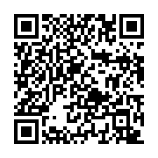
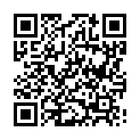
Phrozen GO - Download
Please update your Sonic Mighty 8K firmware to V1.3.6 or above.
Check the firmware update’s instruction for more information.
Download the “Phrozen GO” app through App Store or Google Play and complete the registration process.
Android
iOS
Sonic Mighty 8K V1.3.6 will be released on 12/29.

Slide 5
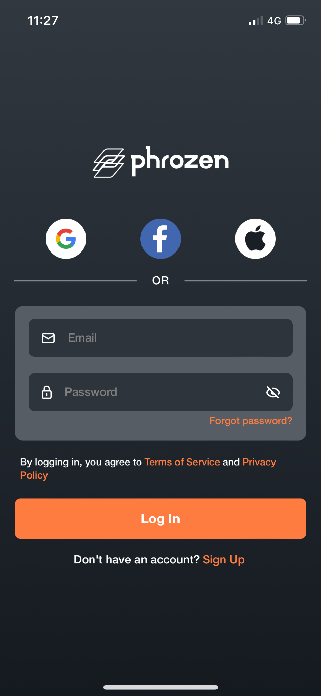
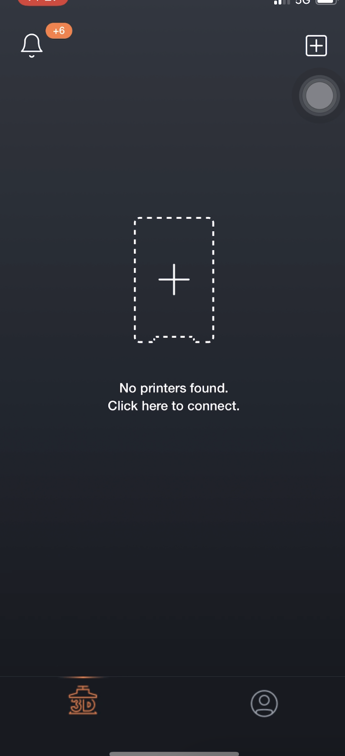
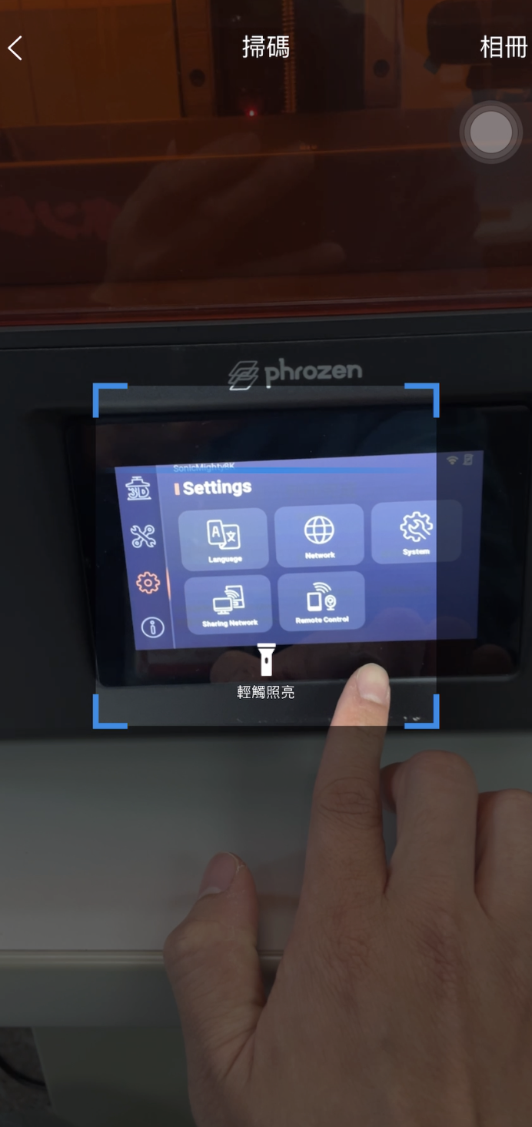
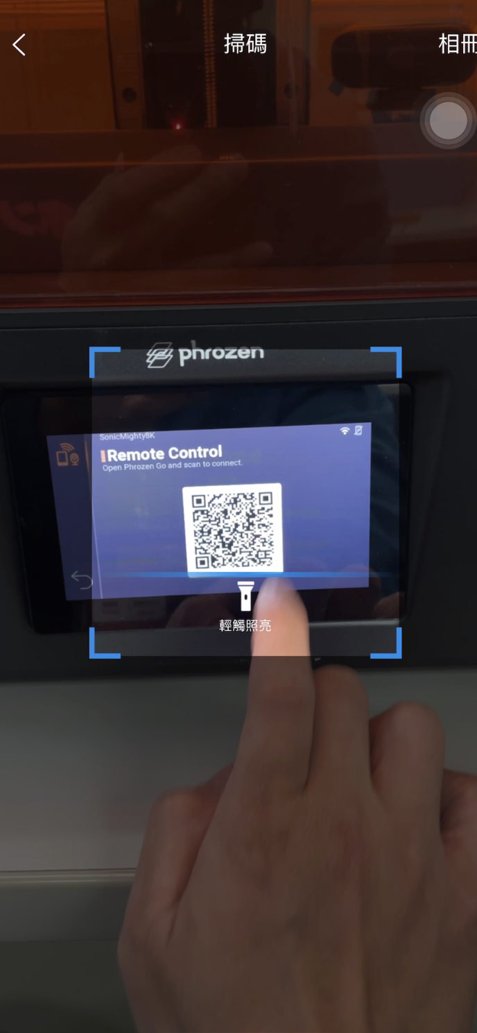
Phrozen GO - Connection Settings
Complete the registration process.
Tap “Add Printer” on the main screen to enter the scanning display.
On the 3D printer’s touch panel, tap “Settings” and choose “Remote Control” to access the 3D printer’s QR code.
Scan the QR code provided on your 3D printer screen to bind your account, then confirm the connection on the 3D printer screen.

Slide 6
Phrozen GO - Add Multiple Printer
To connect multiple printers, return to the main screen and click "Add Printer" in the upper right corner. Repeat the operation to scan and bind your account.

Slide 7
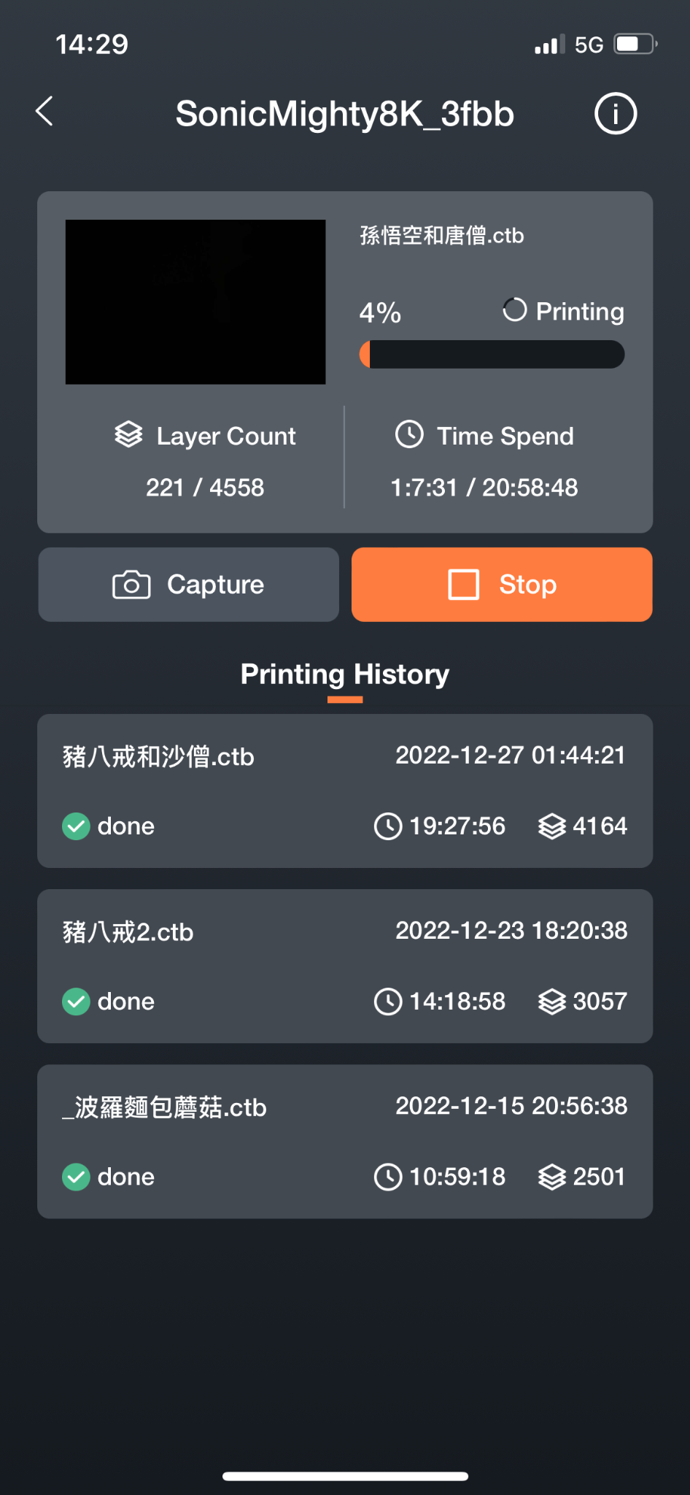
Phrozen GO - Remote Control
Choose the 3D printer you want to check on.
Tap Capture to take a picture or Stop to end your current print.
Tap on the screen to check the captured image.

Slide 8
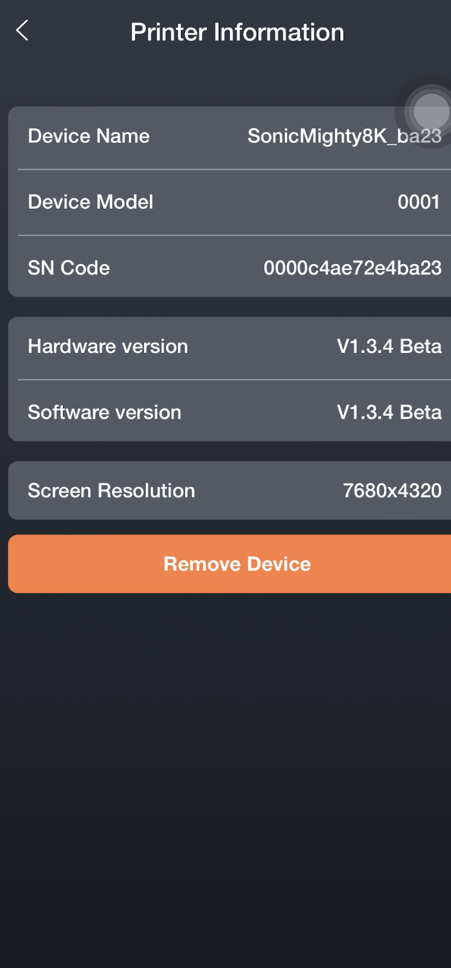
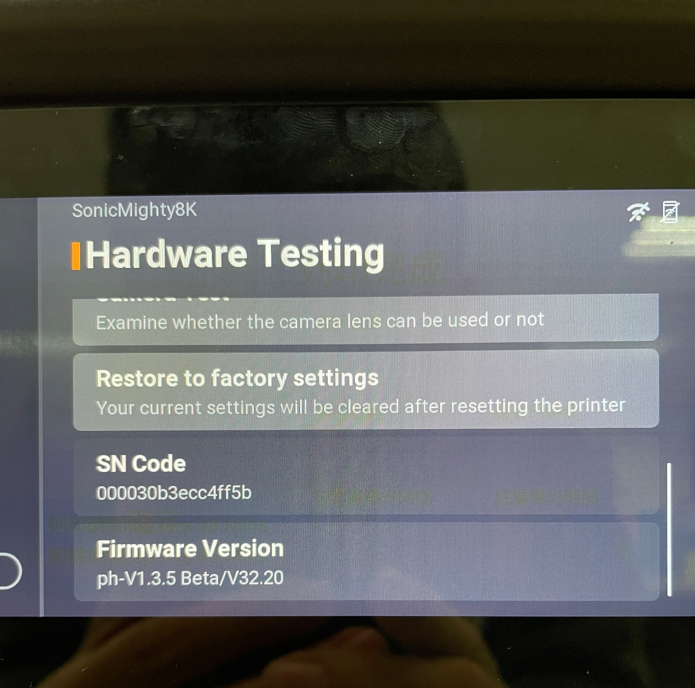
Phrozen GO - Check Connection
To check the devices you are connected to, open Phrozen GO and tap Printer Information > SN Code.
On your 3D printer, choose Settings > System > Hardware Testing > SN Code. The connected device and 3D printer will display the same SN Code.
000030b3exx4ff5b
Notice:
One 3D printer can only be bound to one Phrozen GO account at a time. If you want to use the 3D printer with a different account, please unbind the original account first before binding it to another account.

Slide 9
Phrozen GO - Unbinding
To unbind your account, choose the 3D printer you want to unbind from on your Phrozen GO app. Tap on the top right corner to access Printer Information and choose Remove Device.

